Slide 1

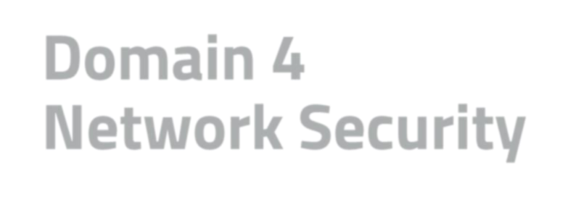
Domain 4 Agenda
Domain 4 Network Security
Module 1: Understand Computer Networking
Module 2: Understand Network (Cyber)
Threats and Attacks
Module 3: Understand Network
Security Infrastructure

Slide 2
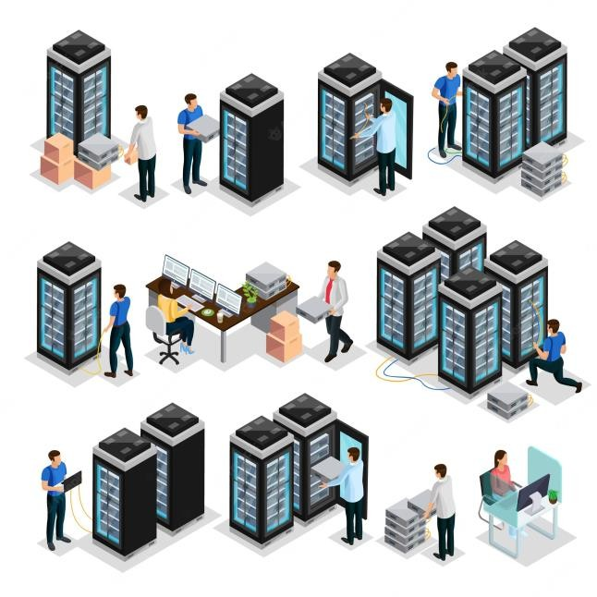
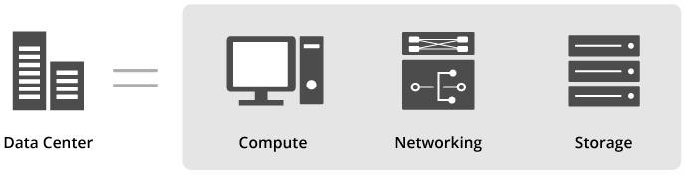

What is a Data Center?
A Data Center is a facility that provides shared access to applications and data using a complex network, compute, and storage infrastructure

Slide 3
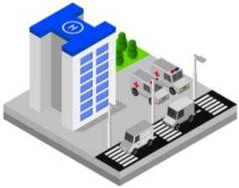
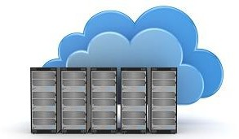
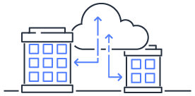

Data Centers (DC) Types
On-Premises Data Centers
A group of servers that you own and control in a Physical location you own that allows you to have full control of your infrastructure
Cloud Data Centers
A Virtual infrastructure where an organization rents an infrastructure managed by a third-party partner and accesses it by internet
Hybrid Data Centers
Combines on-prem and cloud-based infrastructure with orchestration that allows data and applications to be shared between them over the network

Slide 4

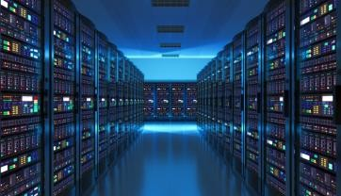
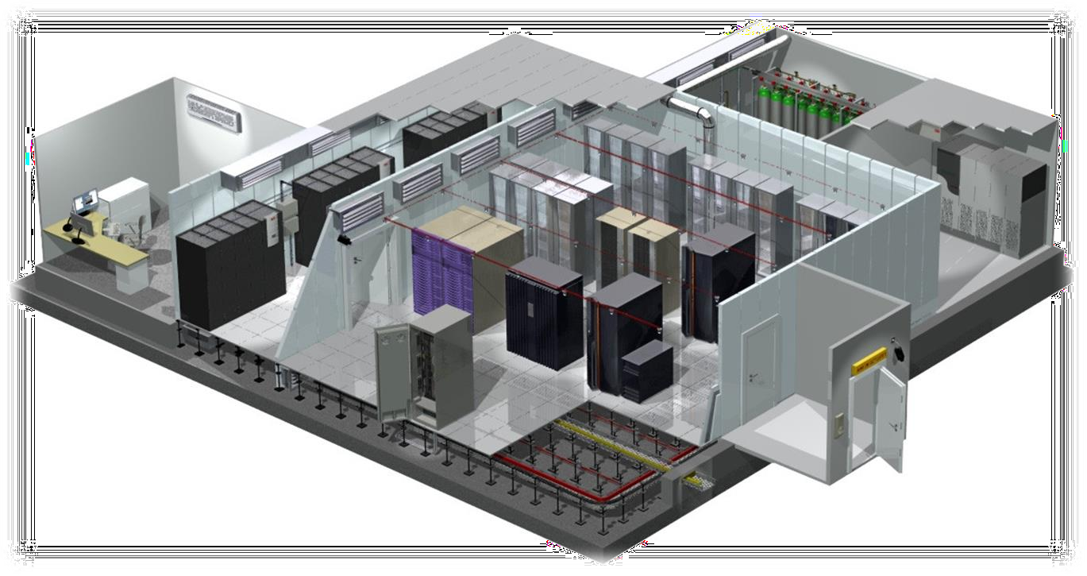



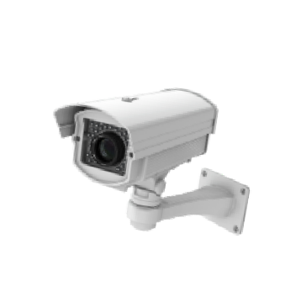

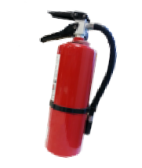





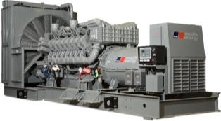


Data Center Components
Power (UPSs)
HVAC System
Fire Suppression
DC Monitoring Room
Power (Fuel Generator)
CCTV
Closets
(Network, Servers, Routers and Switches)
Mantrap

Slide 5
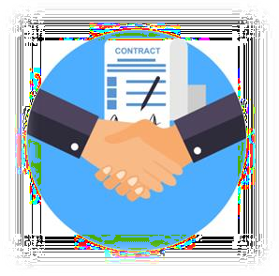

Joint Operating Agreements (JOA)
Memorandum of Understanding (MOU)
Memorandum of Agreement (MOA)
Definition:
⌾ Agreements with other, similar organizations. They agree that if one of the parties experiences an emergency and cannot operate within their own facility, the other party will share its resources and let them operate within theirs in order to maintain critical functions.
Goal:
⌾ Minimize downtime and enhance BC (Business Continuity) and DR (Disaster Recovery) capabilities

Slide 6
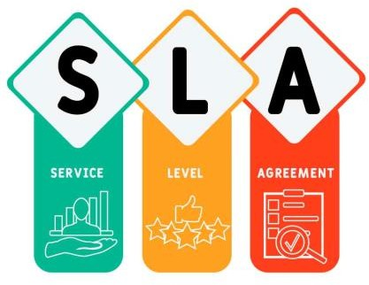
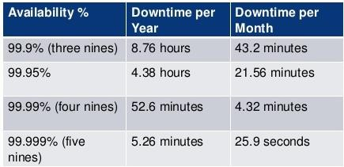

Service Level Agreement
Definition:
⌾ A Service Level Agreement (SLA) is a contractual agreement that states that a service provider guarantees a certain level of service. If the service is not delivered at the agreed-upon level (or better), then there are consequences (typically financial) for the service provider
Examples:
⌾ An Internet service provider (ISP) may sign an SLA of 99.999 percent (commonly called “five nines”) uptime to the Internet backbone

Slide 7
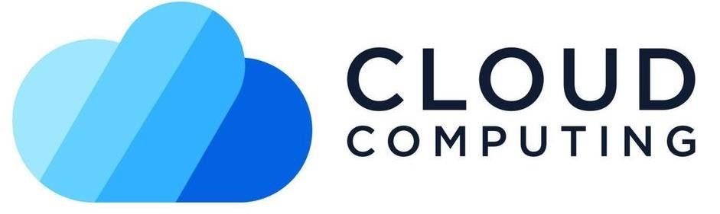
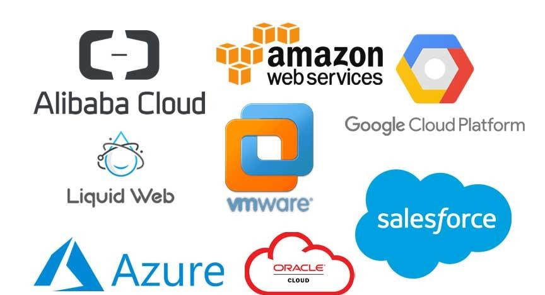

A model for enabling ubiquitous, convenient, on-demand network access to a shared pool of configurable computing resources (e.g., networks, servers, storage, applications, and services) that can be rapidly provisioned and released with minimal management effort or cloud service provider (CSP) interaction.

Slide 8

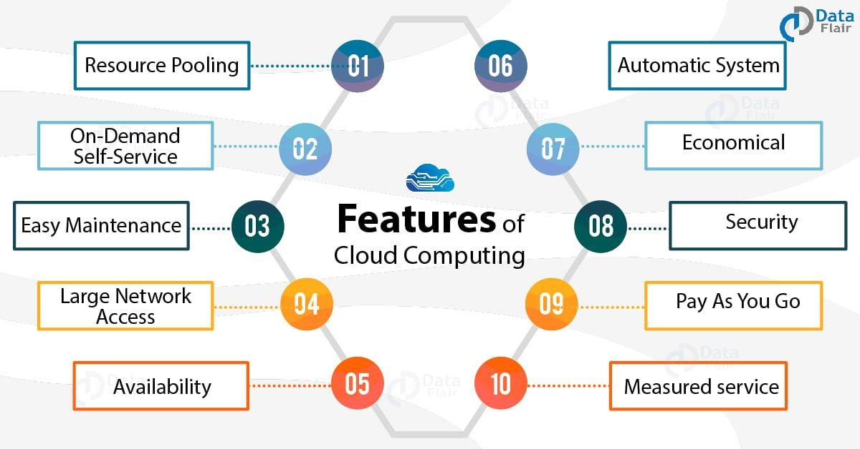

https://data-flair.training/blogs/features-of-cloud-computing/

Slide 9
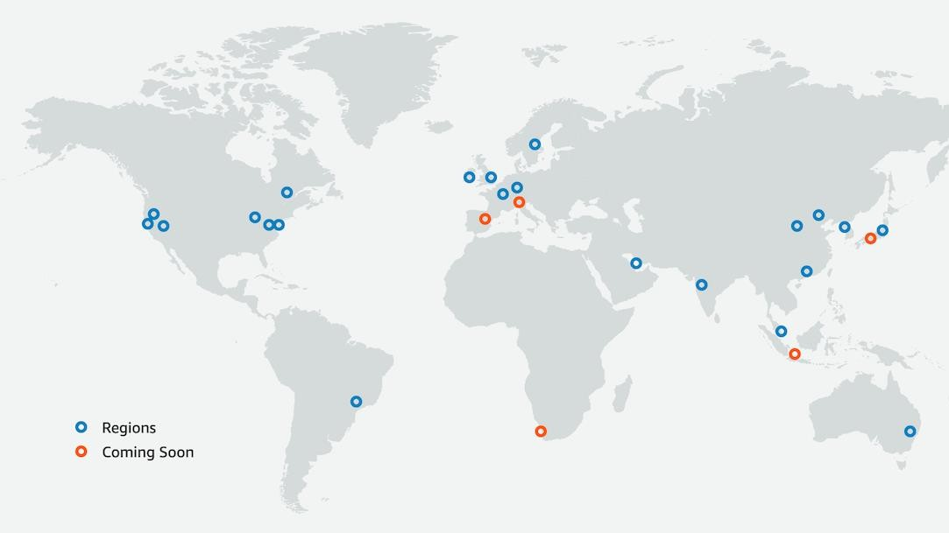

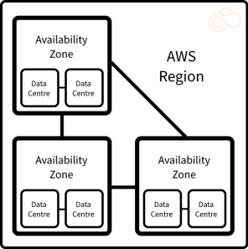



Regions and availability zones
Each Region is a separate
geographic area.
Availability Zones are multiple, isolated locations within each Region

Slide 10
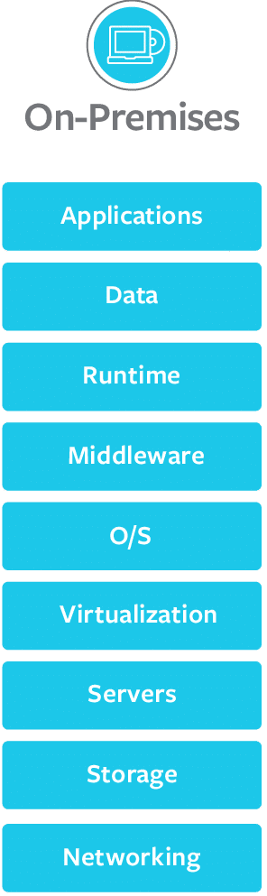
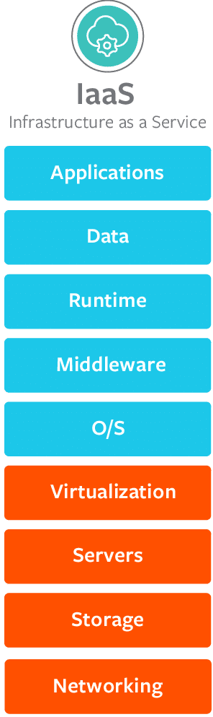
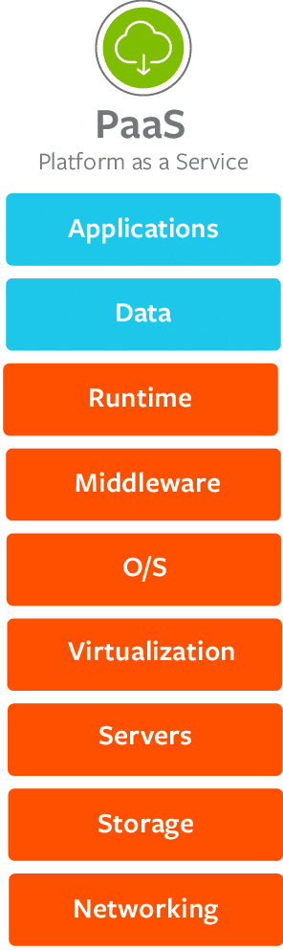
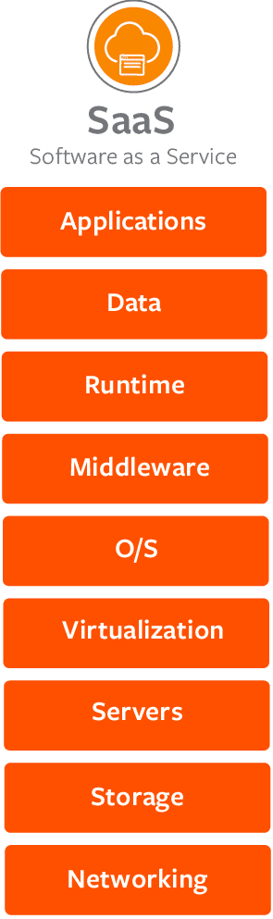


Cloud Service Models

Slide 11

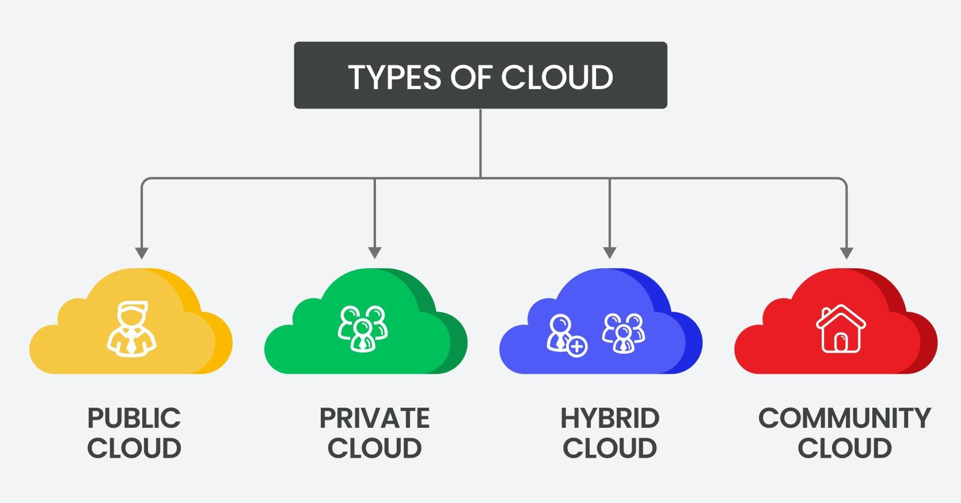









Combines public (coCntoaminms unity clouds can be
It is open to the public and Sisa, me concept as public clouds,
therefore, a shared resourceexcept that this deployment non-critical assets) aneditphreirvpauteblic or private.
that many people will be abmleotdoel includes cloud-based (contains critical assetGs)encleoruadllsy developed for a
to reduce cost and mepeatrticular community (similar
use as part of a resource poaossl.ets for a single organization.
business needs business and functions)

Slide 12

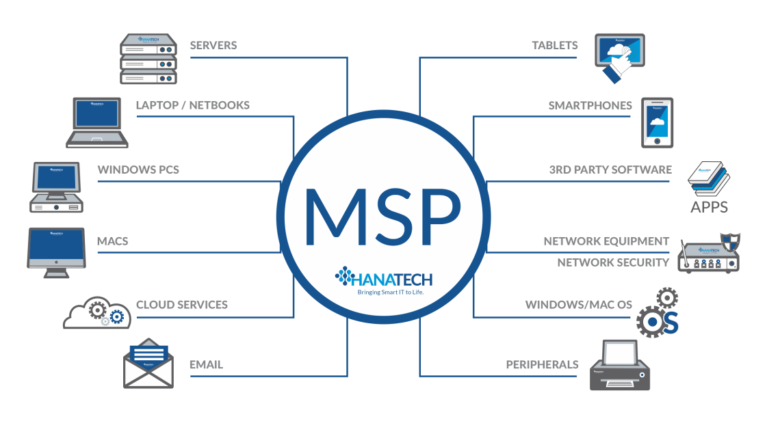

Managed Service Provider (MSP)
A managed service provider (MSP) is a company that manages information technology assets for another company.
Mainly used by Small- and medium-sized businesses
Can be used to provide network and security monitoring and
patching services such as managed detection and response (MDR)

Slide 13

















Network & Cloud Security
Network
Segmentation
Micro
Segmentation
DMZ
VLAN
Zero Trust
NAC
VPN

Slide 14
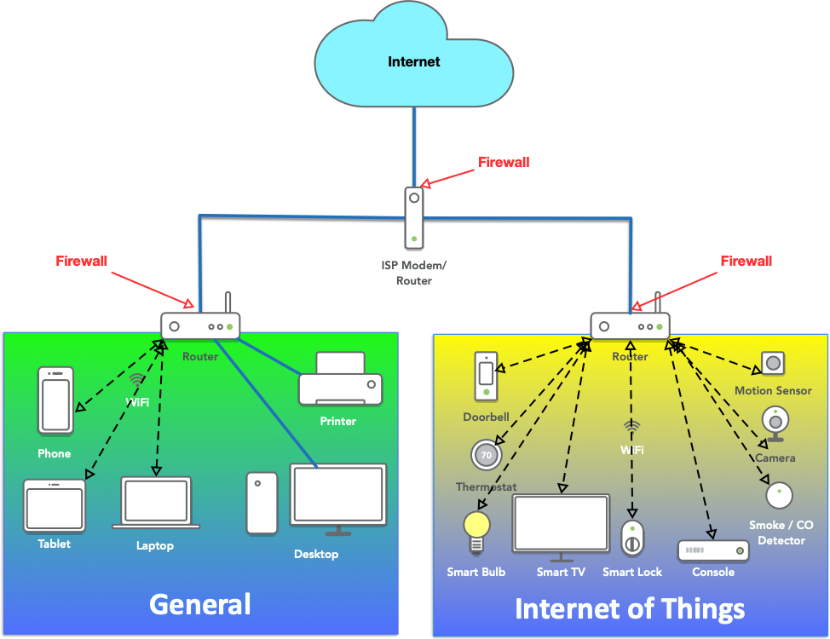

Network Segmentation
Network segmentation involves controlling traffic among networked devices. Complete or physical network segmentation occurs when a network is isolated from all outside communications, so transactions can only occur between devices within the segmented network.

Slide 15

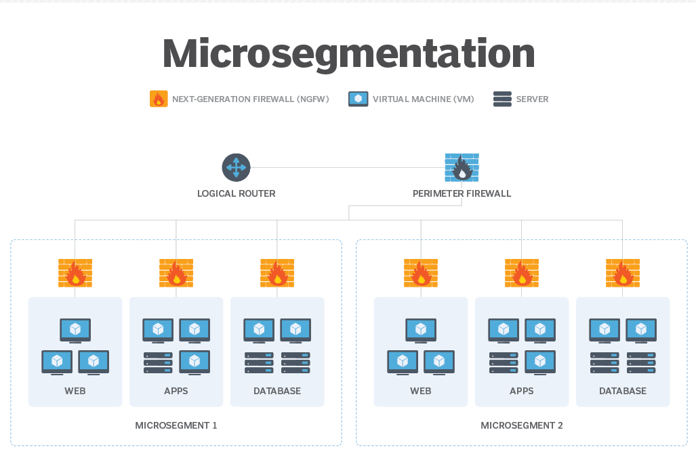

Microsegmentation
A method of creating zones in data centers and cloud environments to isolate workloads via security policies that limit user access.

Slide 16

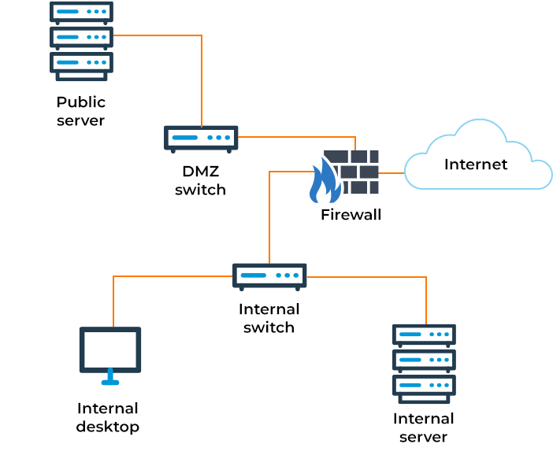

Demilitarized Zone
(DMZ)
A subnetwork containing an organization's exposed, outward- facing services. It acts as the exposed point to an untrusted network, commonly the internet.
Examples of DMZ services: Web and Email servers

Slide 17
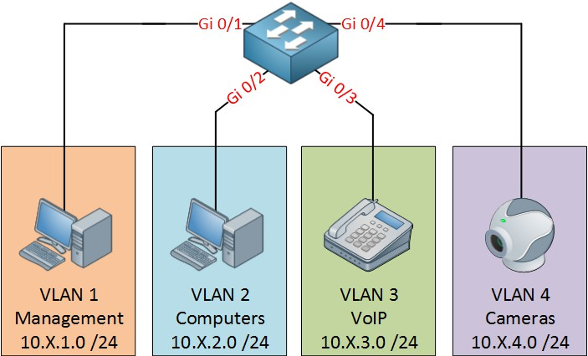





Virtual Local Area Network
(VLAN)
A logical network created by switches that groups together a subset of devices that share a physical LAN, isolating the traffic for each group without altering its physical topology.
2nd Floor
1st Floor
18

Slide 18

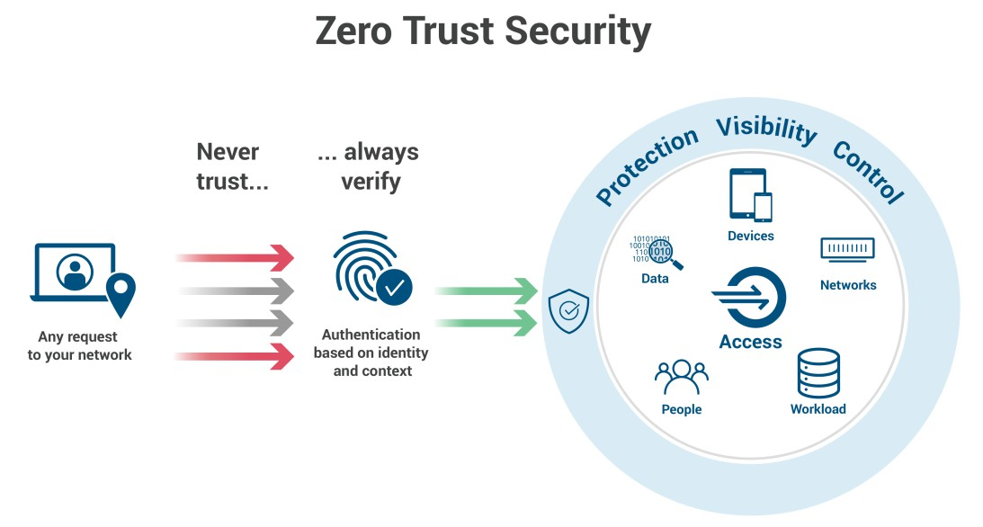

Zero Trust
A security framework requiring all users, whether in or outside the organization's network, to be authenticated, authorized, and continuously validated for security configuration and posture before being granted or keeping access to applications and data.

Slide 19
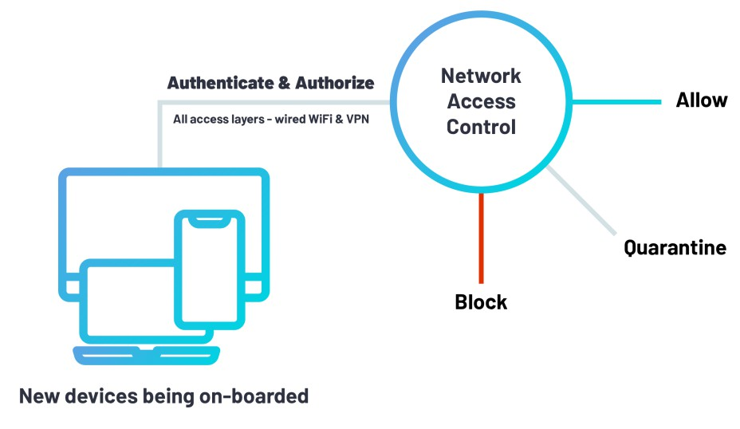

Network access control (NAC)
Network access control (NAC) is a security solution that enforces policy on devices that access networks to increase network visibility and reduce risk.
NAC deployment:
IoT devices
BYOD/mobile devices (laptops, tablets, smartphones)
Guest users and contractors

Slide 20
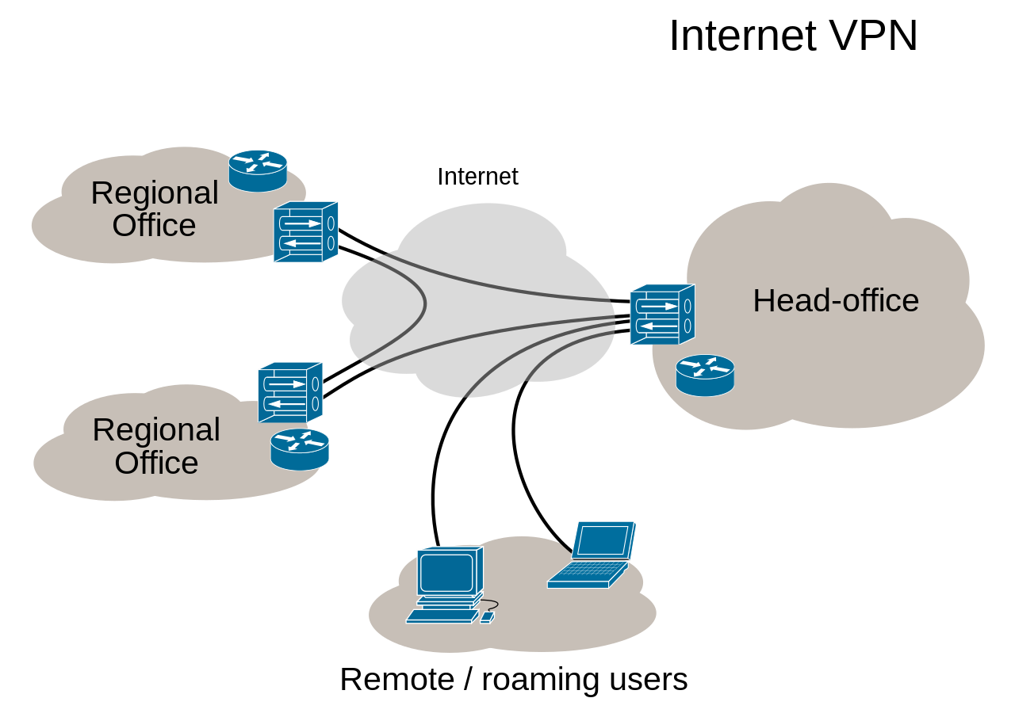

Virtual Private Network
(VPN)
A mechanism for creating a virtual connection between a computing device and a computer network, or between two networks, using an insecure communication medium such as the public Internet.
The tunnel (connection) is not encrypted by default. That’s why some secure VPN protocols must be used, such as: IPSec, SSL/TLS

